Slide 1
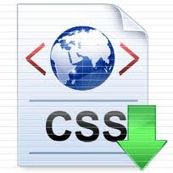
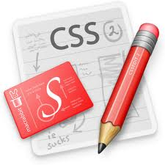
IT4103 Web Programming
www.hndit.com
Week2 - Cascading Style Sheet (CSS)

Slide 2
Aim/ Objectives
www.hndit.com
To build student awareness of style sheet mechanism available to web programmers seeking to develop and interactive web sites.
At the same time students will develop practical expertise in CSS providing them with a solid foundation from which to develop a mastery of web programming techniques

Slide 3
Learning Outcome
www.hndit.com
Use style sheets to enhance the user interface of a web site.

Slide 4
Cascading Style Sheet
www.hndit.com
Cascading Style Sheet (CSS) is a style sheet language used to describe the presentation of a document written in a markup language (e.g. HTML and XHTML).
CSS is a list of statements (rules) that define colors, fonts, layout, and other aspects to HTML elements.

Slide 5
Why Use Style Sheets?
www.hndit.com
It allows much greater degree of layout and display control.
The amount of format coding necessary to control display characteristics can be greatly reduced.
It allows multiple styles to be attached to a document at once.
It also allows for all the style formatting in a document to be changed at once, thus a document can be easily formatted for different purposes (online, brochures, printing, etc.).

Slide 6
Three ways to insert CSS
www.hndit.com
External style sheets, i.e. a separate CSS-file referenced from the document
Embedded style (internal), blocks of CSS information inside the HTML document itself
Inline style, attaches a style definition within the HTML element it is modifying

Slide 7
Inline Style
www.hndit.com
To use inline styles you use the style attribute in the relevant tag. The style attribute can contain any CSS property.

Slide 8
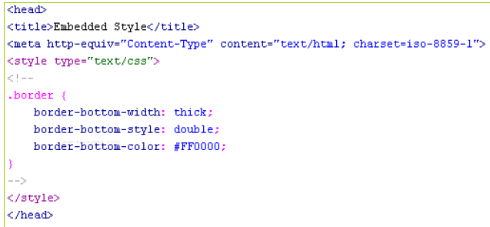
Embedded / internal Style Sheet
www.hndit.com
An internal style sheet should be used when a single document has a unique style. You define internal styles in the head section of an HTML page, by using the <style> tag

Slide 9
External Style Sheet
www.hndit.com
An external style sheet is ideal when the style is applied to many pages. With an external style sheet, you can change the look of an entire Web site by changing one file. Each page must link to the style sheet using the <link> tag. The <link> tag goes inside the head section

Slide 10
Cascading order
www.hndit.com
What style will be used when there is more than one style specified for an HTML element? (multiple style sheets)
Inline style (inside an HTML element)
Internal style sheet (in the head section)
External style sheet
Browser default
Notes:
So, an inline style (inside an HTML element) has the highest priority, which means that it will override a style defined inside the <head> tag, or in an external style sheet, or in a browser (a default value).
Note: If the link to the external style sheet is placed after the internal style sheet in HTML <head>, the external style sheet will override the internal style sheet!

Slide 11
Defining a Style
www.hndit.com
CSS style definitions follow the format given below:
selector_expression {
element_property: property_value(s);
element_property: property_value(s);
…
}
The selector_expression is an expression that can be used to match specific elements (HTML elements/tags) in the document; the element_property specifies which properties of the element the definition will affect, and each property can take a value. The property and value are separated by a colon, and surrounded by curly braces.
Notes:
The selector is normally the HTML element you want to style.
Each declaration consists of a property and a value.
The property is the style attribute you want to change. Each property has a value.

Slide 12
Example Code
www.hndit.com
<!DOCTYPE html>
<html>
<head>
<style type="text/css">
body
{
background-color:yellow;
}
h1
{
background-color:#00ff00;
}
p
{
background-color:rgb(255,0,255);
}
</style>
</head>
<body>
<h1>This is heading 1</h1>
<p>This is a paragraph.</p>
</body>
</html>

Slide 13
Example -view
www.hndit.com

Slide 14
Property Values and Units
www.hndit.com
CSS supports the following metrics for property values :
CSS keywords and other properties, such as thin, thick, transparent, ridge, and etc.
Real-world measures
Inches (in)
Centimeters (cm)
Millimeters (mm)
Points (pt) – The points used by CSS2 are equal to 1/72 of an inch
Picas (pc) – 1 pica is equal to 12 points
Screen measures in pixels (px)
Relational to font size (font size (em) or x-height size (ex))
Percentages (%)
Color codes (#rrggbb or rgb(r,g,b) )
Notes:
if the font-size of the document is 12pt, 1em is equal to 12pt. Ems are scalable in nature, so 2em would equal 24pt, .

Slide 15
Property Values and Units
www.hndit.com
Angles
Degrees (deg)
Radians (rad)
Time values (seconds (s) and milliseconds (ms)) – Used with aural style sheets
Frequencies (hertz (Hz) and kilohertz (kHz)) – Used with aural style sheets

Slide 16
Selectors
www.hndit.com
Selectors are essentially patterns that enable a user agent to identify what elements get what styles.
– E.g. “If it is a paragraph tag, give it this style”:
p { text-indent: 2em; }
The ways of matching:
Matching elements by name
Matching using the universal selector
Matching elements by class
Matching elements by identifier
Matching elements by specific attributes

Slide 17
Matching Elements by Name
www.hndit.com
Example:
h1 { color: green; }
Causes all occurrences of the selector tags (h1) to be formatted with the property/value section of the definition (color: green)
Multiple selectors
Example
h1, h2, h3, h4 { color: green; }

Slide 18
Matching Using the Universal Selector
www.hndit.com
The universal selector (*) can be used to match any element in the document.
E.g.
Match every tag and apply the color red:
* { color: red; }
Match any <ol> tag that is a descendant of a <td> tag, which is a descendant of a <tr> tag: tr td ol { color: red; }

Slide 19
Matching Elements by Class
www.hndit.com
With the class selector you can define different styles for the same type of HTML element.
Say that you would like to have two types of paragraphs in your document: one right-aligned paragraph, and one center-aligned paragraph. Here is how you can do it with styles:
p.right {text-align: right}
p.center {text-align: center}
You have to use the class attribute in your HTML document:
<p class="right">This paragraph will be rightaligned.</p>
<p class="center">This paragraph will be centeraligned.</p>

Slide 20
Matching Elements by Class
www.hndit.com
To apply more than one class per given element, the syntax is:
<p class="center bold"> This is a paragraph. </p>
The paragraph above will be styled by the class "center" AND the class "bold".
You can also omit the tag name in the selector to define a style that will be used by all HTML elements that have a certain class. In the example below, all HTML elements with class="center" will be center-aligned:
.center {text-align: center}
<h1 class="center">This heading will be center-aligned. </h1>
<p class="center">This paragraph will be centeraligned.</
p>

Slide 21
Matching Elements by Identifier
www.hndit.com
You can also match element identifiers (the id attribute).To match identifiers, you use the pound sign (#) in the selector as a prefix for the id. E.g.
#comment {background-color: green}
…
<p class=“comment">This paragraph is a comment.</p>

Slide 22
Matching elements by Specific Attributes
www.hndit.com
To match any attribute in elements, not just class and id, the attribute and the value(s) have to be specified at the end of the selector, offset in square brackets.E.g.
Match any table with a border attribute set to 3, table[border=“3”]
Match any table with a border attribute, table[border]
Match any table elements with a class value of datalist and border value of 3, table.datalist[border=“3”]

Slide 23
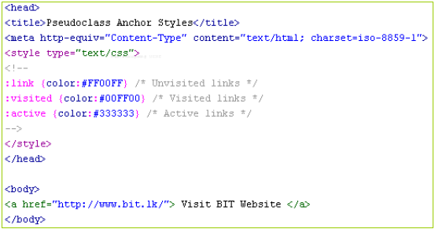
Pseudo-classes
www.hndit.com
Pseudo classes are identifiers that are understood by user agents and apply to elements of certain types without the elements having to be explicitly styled.
E.g. Anchor styles

Slide 24
Fonts
www.hndit.com
Fonts are styled collection of letters and symbols. Different fonts can be used to convey different information.
CSS supports five different font family types:
Serif fonts They are used in body text; the finishing strokes, flared or tapering ends, or serifed endings, make the lines of characters flow and tend to be easier on the eyes.
Sans serif fonts They are used for headings or other large areas of emphasis.
Cursive fonts They are used in extreme cases where emphasis is on ornamentation rather than legibility.
Fantasy fonts They are used for logos and other ornamentation purposes where legibility is secondary.
Monospace fonts They are used in code listings and other approximating terminal output.

Slide 25
Font Characteristics
www.hndit.com
Fonts are mapped according to a system similar to ruled paper.
The line that the characters or symbols sit on is called the baseline.
The distance between the baseline and the top of the highest characters (usually capital letters and lowercase letters such as l, f or t ) is known as the ascension.
The distance between the baseline and the lowest point of characters that dip below it (such as p, g or q) is known as the descension.

Slide 26
Defining a Font Family
www.hndit.com
The font-family property defines the font or fonts should be used for elements in the document.
More than one font family names is defined with a generic family name for versatility.

Slide 27
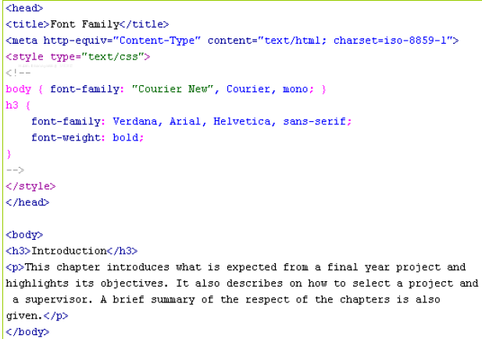
Defining a Font Family
www.hndit.com

Slide 28
Some Other Font Properties
www.hndit.com
Font sizing
– Two properties can be used to control font sizing: font-size and font-size-adjust. Both properties can adjust a font absolutely or relative to the current font size.
Font styling
Four properties can be used to affect font styling: font-style, font-variant, font-weight, and font-stretch.
Line spacing
The line-height property controls the line height of text, i.e. the distance between the baseline of two vertically stacked lines of text.

Slide 29
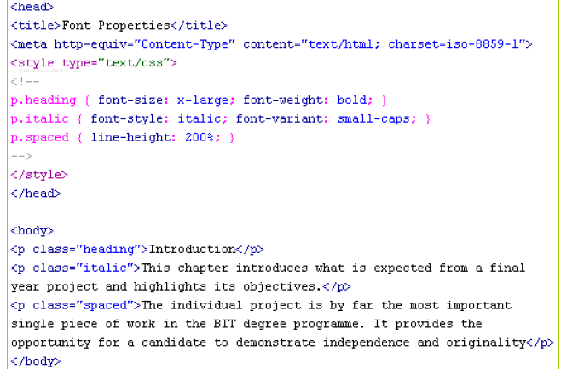
Example -Code

Slide 30
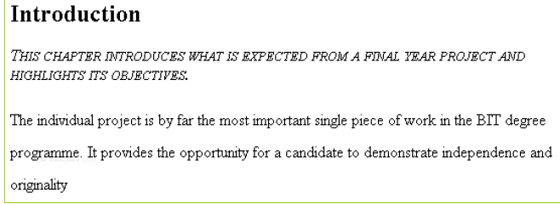
Example - View
www.hndit.com

Slide 31
Colors
www.hndit.com
CSS options for defining colors can entirely replace the color attributes in plain HTML. In addition CSS has the following advantages:
In plain HTML, when you wanted to create an area with a specified color, you were forced to create a table. However, with CSS, you can define an area to have a specific color without that area being part of a table.
In plain HTML, specially when working with tables, you had to specify font attributes and colors etc. for each and every table cell. However, with CSS you can simply refer to a certain class.

Slide 32
Specifying a Color
www.hndit.com
The color value can be expressed using one of three methods:
Color keywords
blue, black, green, and so on
Color hexadecimal values
values specified in the form #rrggbb
•E.g. #FF0000 for red, #000000 for black
– Color decimal or percentage values
Values specified using the rgb() function. The value can be an integer between 0 and 255 or a percentage.
E.g. rgb(100, 0, 100), rgb(50%, 0, 50%)

Slide 33
Specifying a Color
Most elements in a HTML document have two color properties: a foreground color and a background color.
Setting the foreground color for contents
color: <color_value>;
Setting the background color for an area
background-color: <color_value>;
Setting a background image to fill out an area background-image: url(“<url_to_image>”);

Slide 34
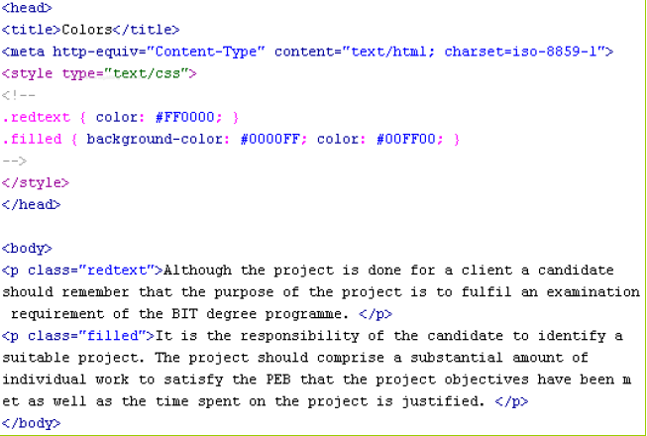
Example- Code
www.hndit.com

Slide 35
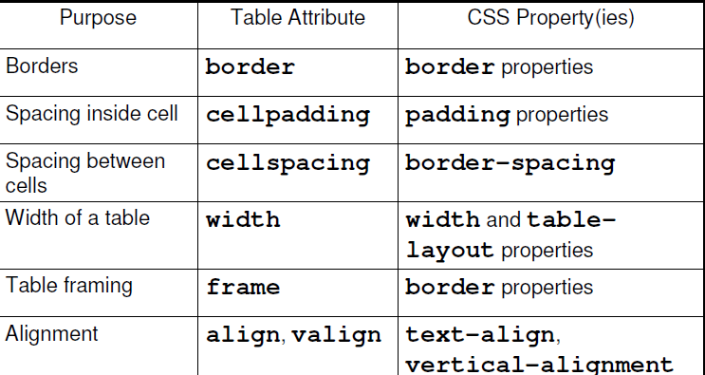
Tables
www.hndit.com
CSS properties available for table attributes:
:

Slide 36
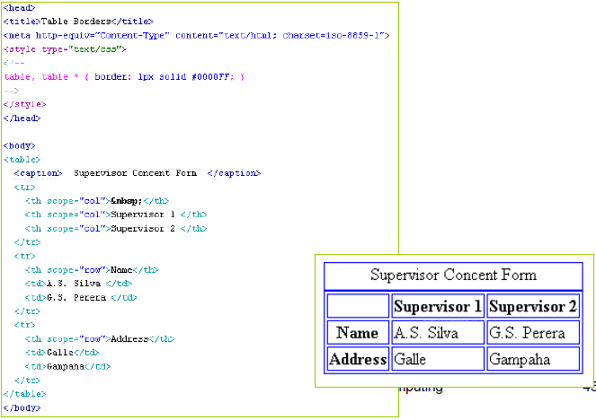
Defining Borders
www.hndit.com

Slide 37
www.hndit.com

